Slide 1
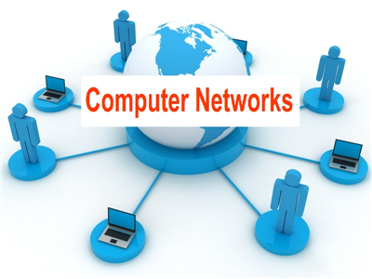
Computer network
A computer network is a set of computers sharing resources located on or provided by network nodes.

Slide 2
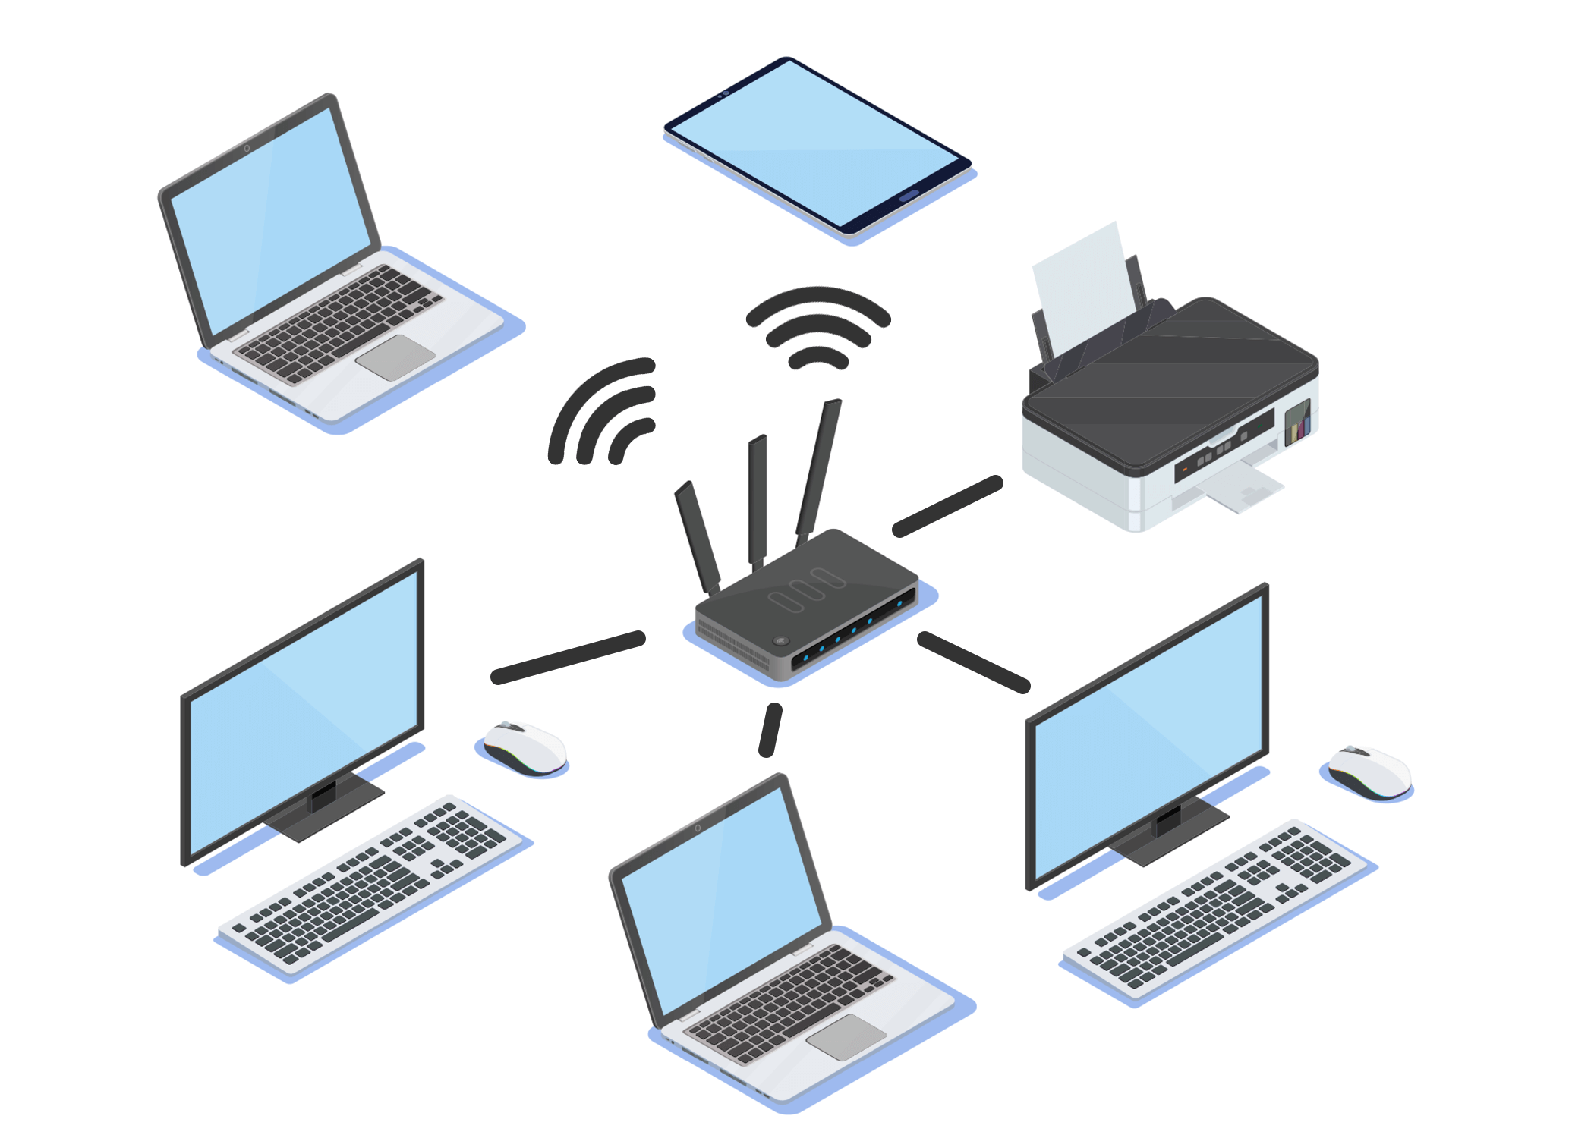
Network computing
Network computing is a generic term in computing which refers to computers or nodes working together over a network.

Slide 3
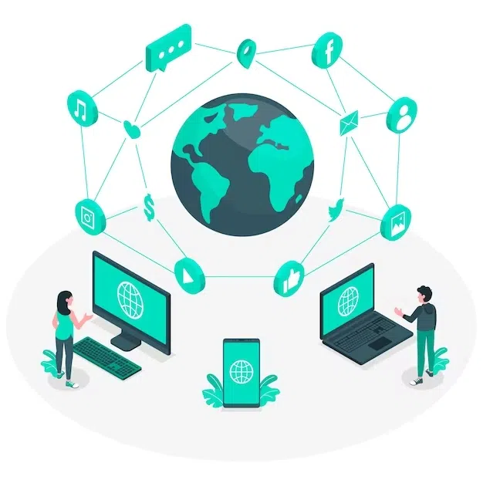
Internet
A global computer network providing a variety of information and communication facilities, consisting of interconnected networks using standardized communication protocols.

Slide 4

WWW
The World Wide Web (WWW), commonly known as the Web, is an information system enabling documents and other web resources to be accessed over the Internet.

Slide 5
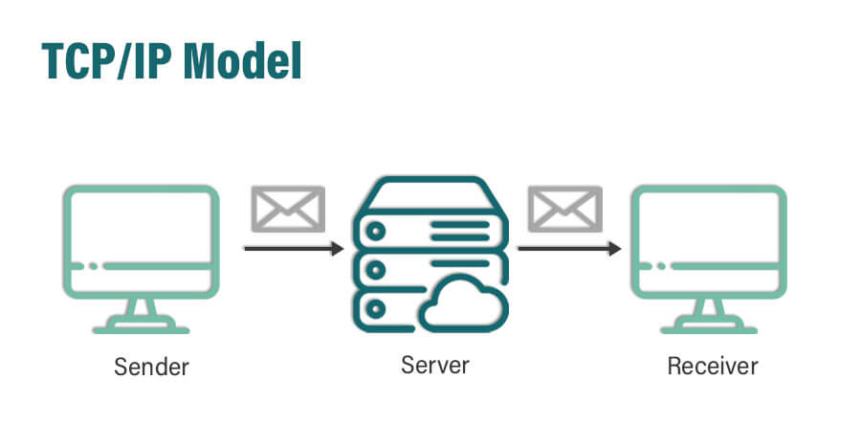
TCP/IP
Transmission Control Protocol/Internet Protocol (TCP/IP) is a networking protocol that allows two computers to communicate.

Slide 6
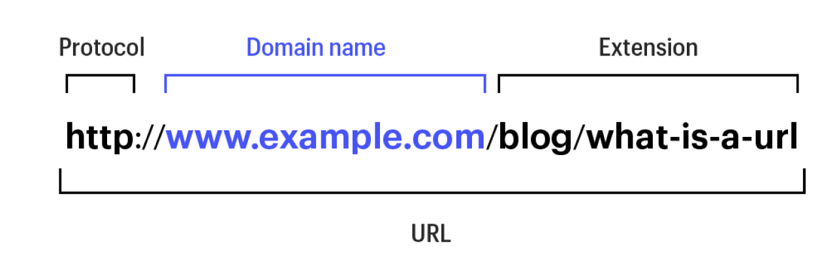
URL
A Uniform Resource Locator, The address of a web page.

Slide 7

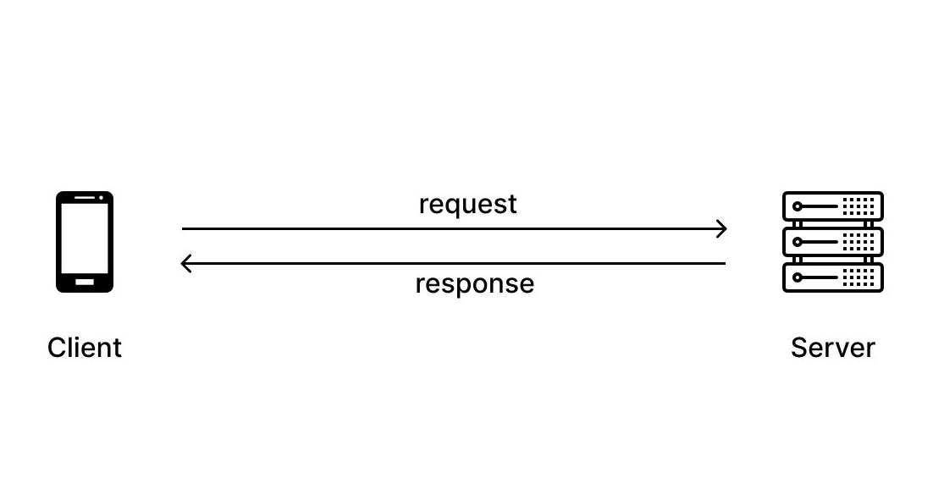
HTTP
Hyper Text Transfer Protocol, specifies the rules for communication between a Web browser and Web Server.

Slide 8
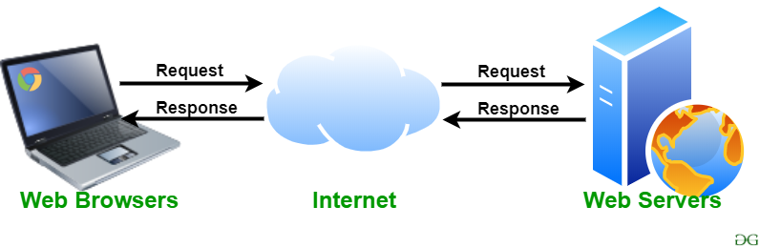
Web server
A web server is a computer that runs websites. It's a computer program that distributes web pages as they are requisitioned.

Slide 9
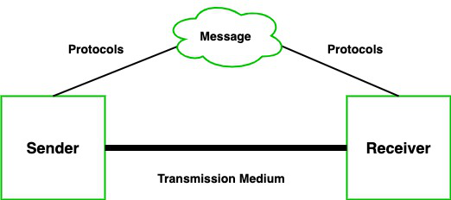
Communication
Communication is usually defined as the transmission of information.
Collaboration is the process of two or more people, entities or organizations working together to complete a task or achieve a goal.

Slide 10
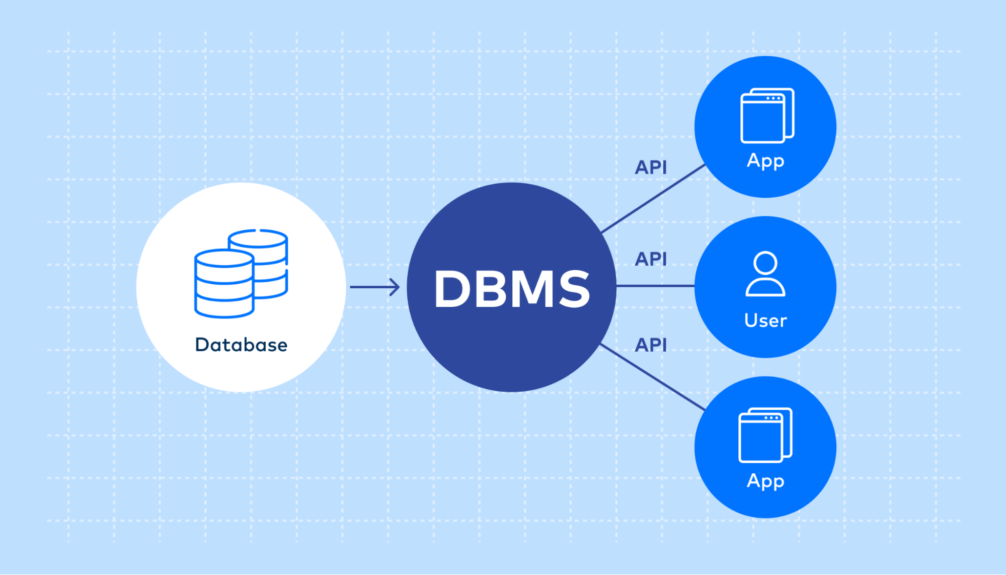
Database
A database is an organized collection of structured information, or data, typically stored electronically in a computer system.

Slide 11

Web Mining
Web Mining is the process of Data Mining techniques to automatically discover and extract information from Web documents and services.

Slide 12
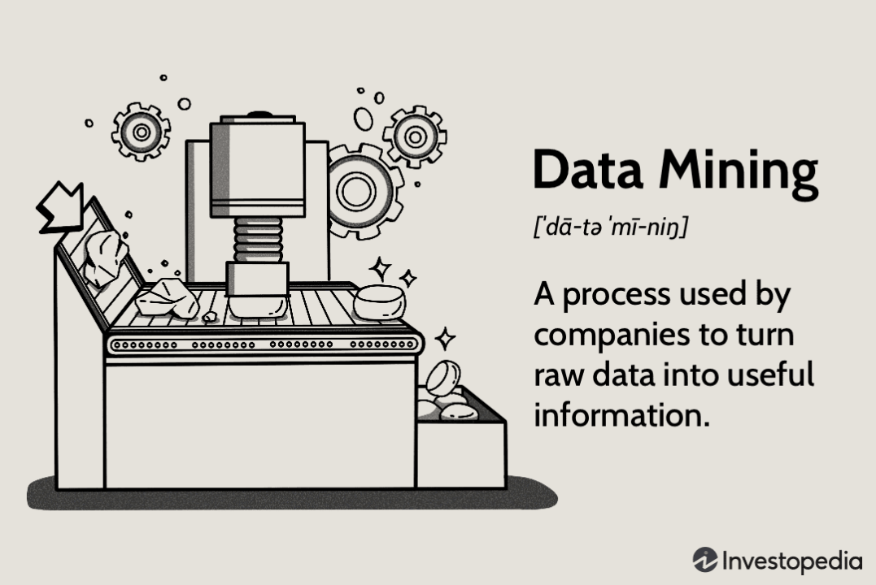
Data mining
The practice of analysing large databases in order to generate new information.

Slide 13

Software agent
A software agent is a computer program that acts on behalf of a user or another program.

Slide 14

Search engine
A search engine is a software system designed to carry out web searches.

Slide 15
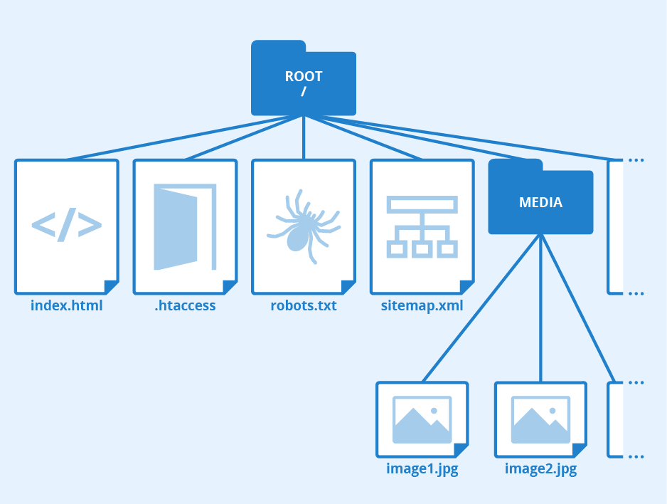
Directory
A directory is a location for storing files on a computer.
Online directories are searchable databases that display a business’ name, address, phone number, and additional information. Local directories dominate the first page of many local search results.

Slide 16
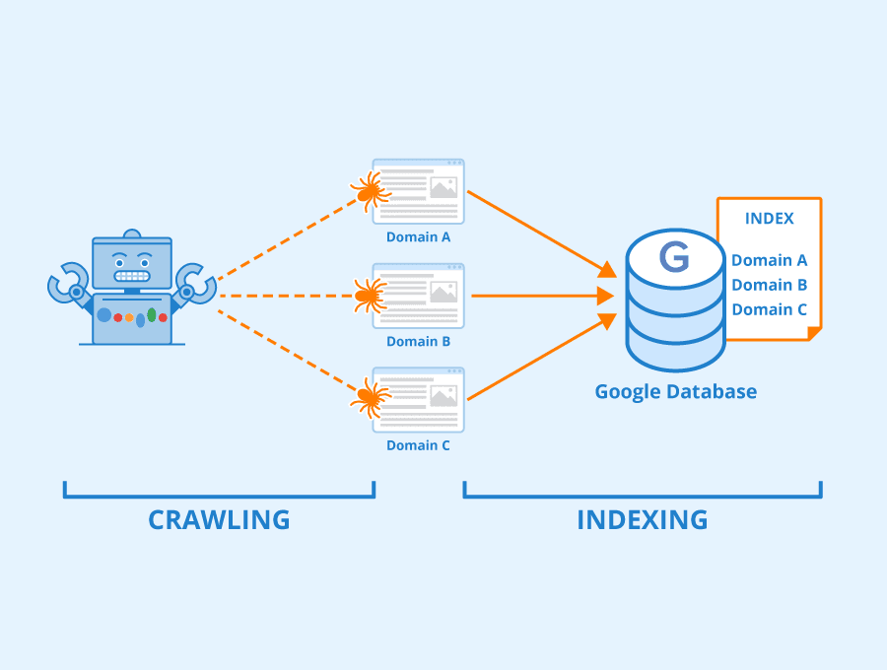
Search engine indexing
Search engine indexing is the collecting, parsing, and storing of data to facilitate fast and accurate information retrieval.

Slide 17
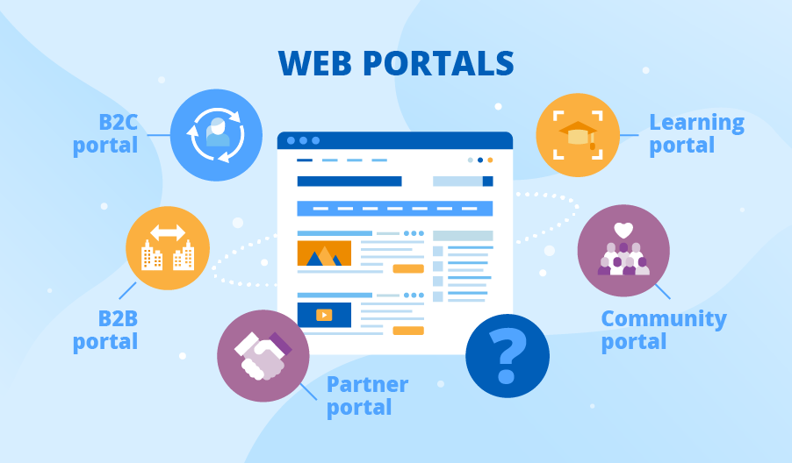
Portals
A web-based personalised gateway to information and knowledge in network computing

Slide 18

Call center
A call center is a centralized office that handles large volumes of inbound and outbound telephone calls.

Slide 19
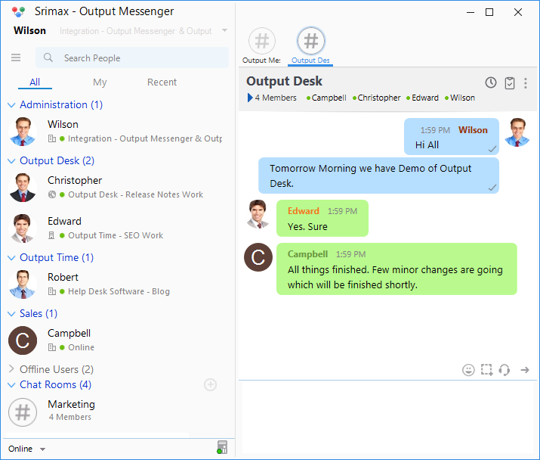
Chat room
A chat room is an online platform that enables users to communicate with each other in real time.

Slide 20

Email
Electronic mail is a method of exchanging messages between people using electronic devices.

Slide 21
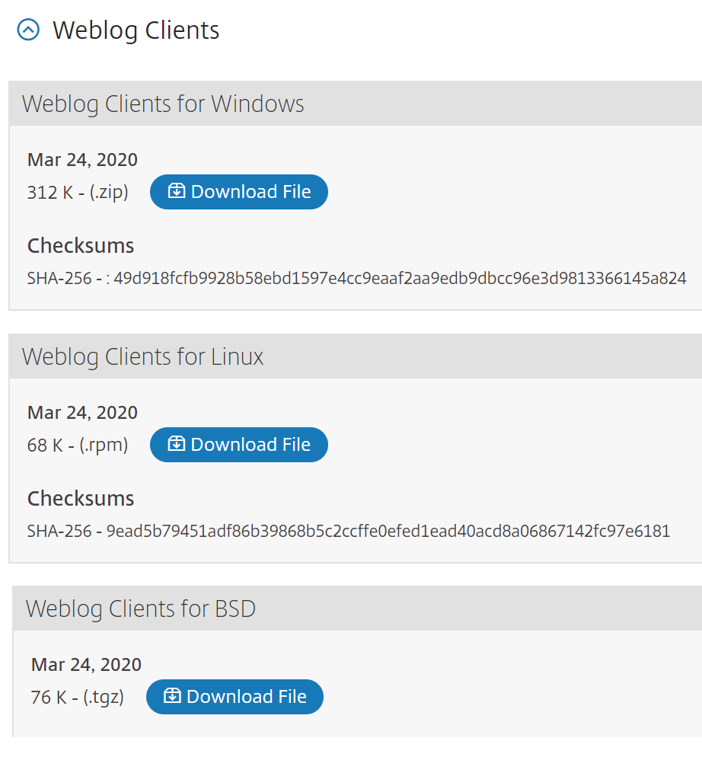
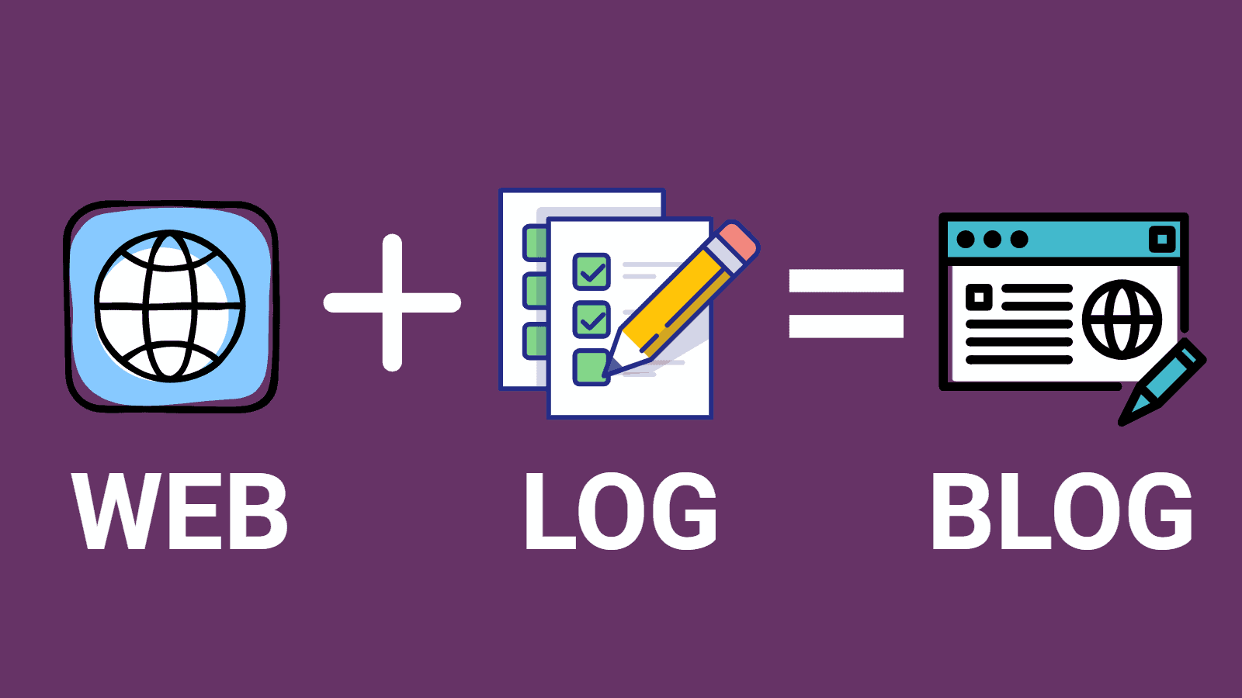
Weblogging
A blog, short for weblog, is a frequently updated web page used for personal commentary or business content.

Slide 22
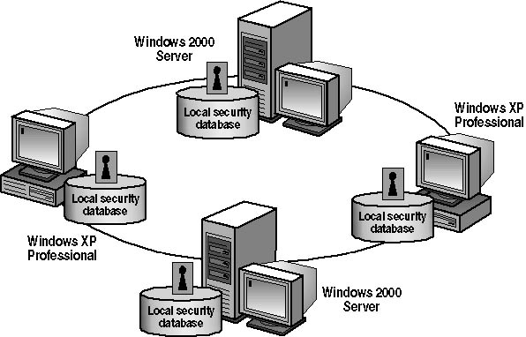

Work group
Two or more individuals who act together to perform some task.

Slide 23

E-collaboration
e-collaboration system" is a computerized system or software which is designed to help individuals and organizations involved in a common task in order to achieve specific goals.

Slide 24
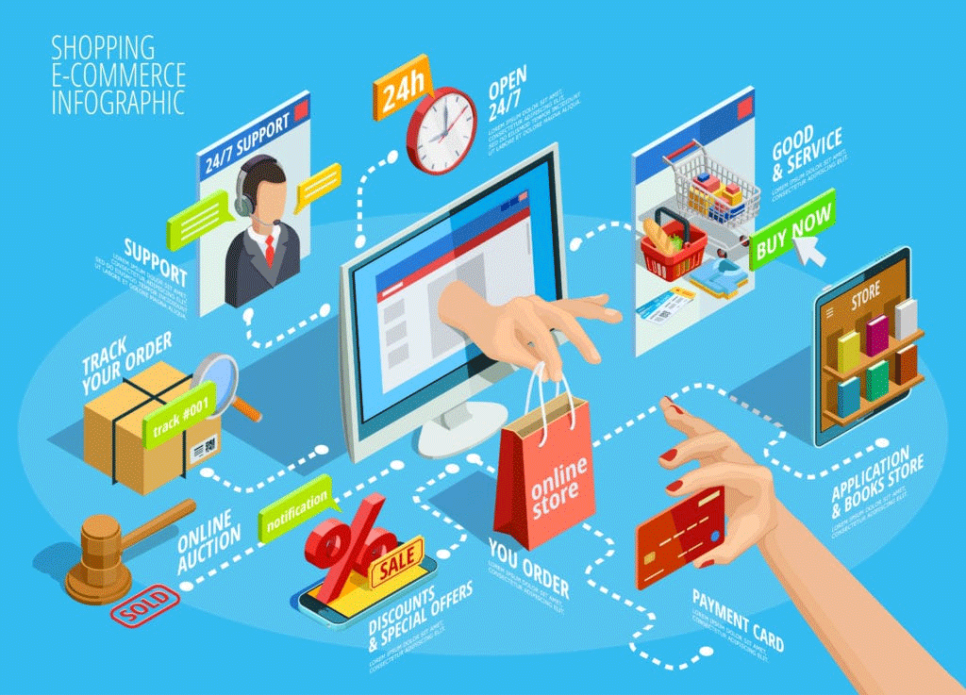
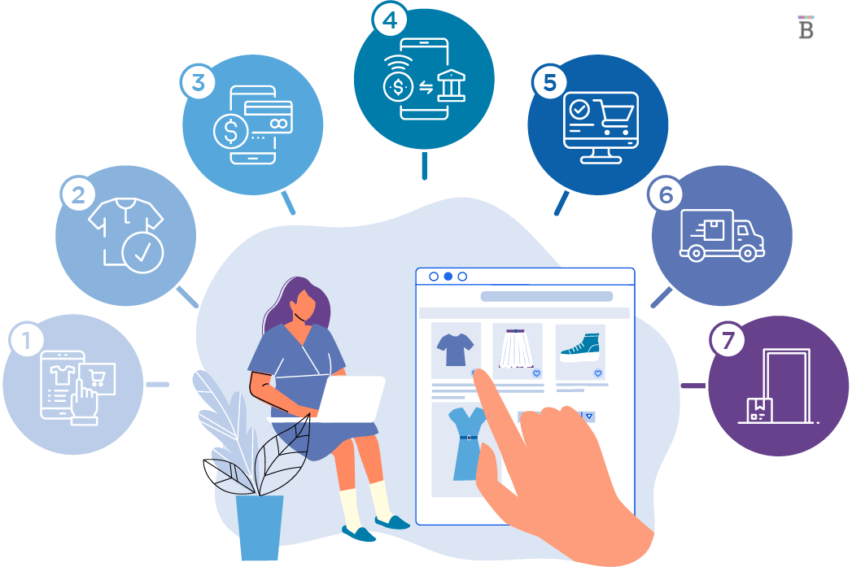
Ecommerce
Ecommerce or electronic commerce is the trading of goods and services on the internet.

Slide 25
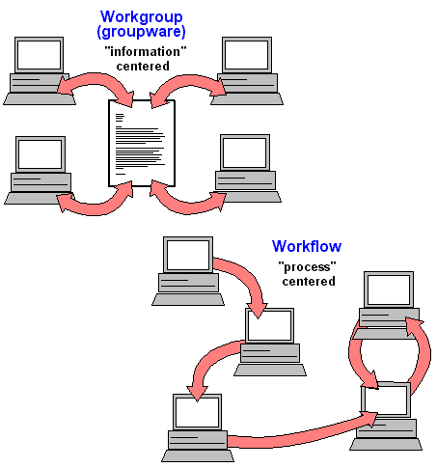
Workflow
Workflow is the series of activities that are necessary to complete a task.

Slide 26
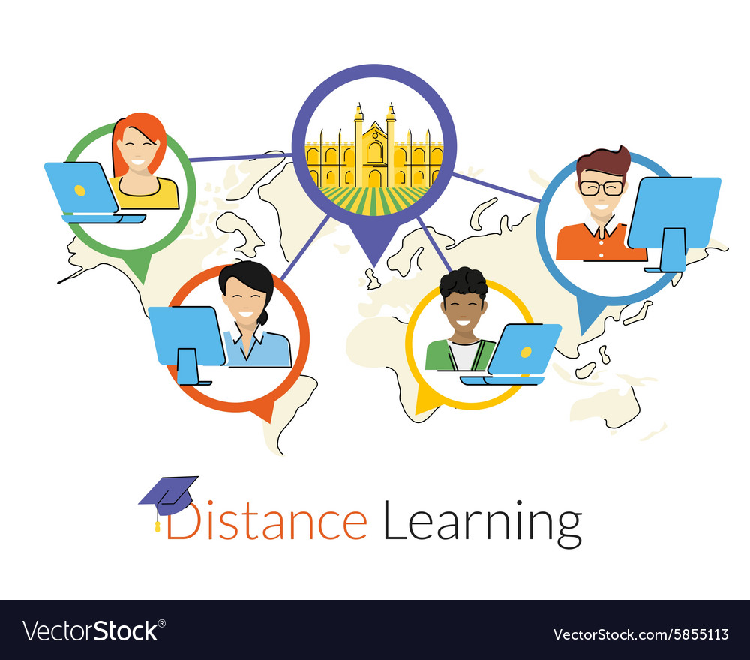
Distance learning
Distance learning” refers to any education provided without the teacher and students being physically present together.

Slide 27

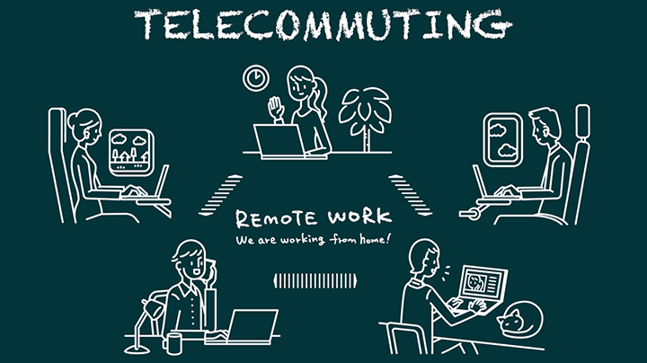
Telecommuting
Also known as 'telework' or 'work from home', telecommuting is an arrangement that allows employees to work away from the company's offices.

